Slide 1
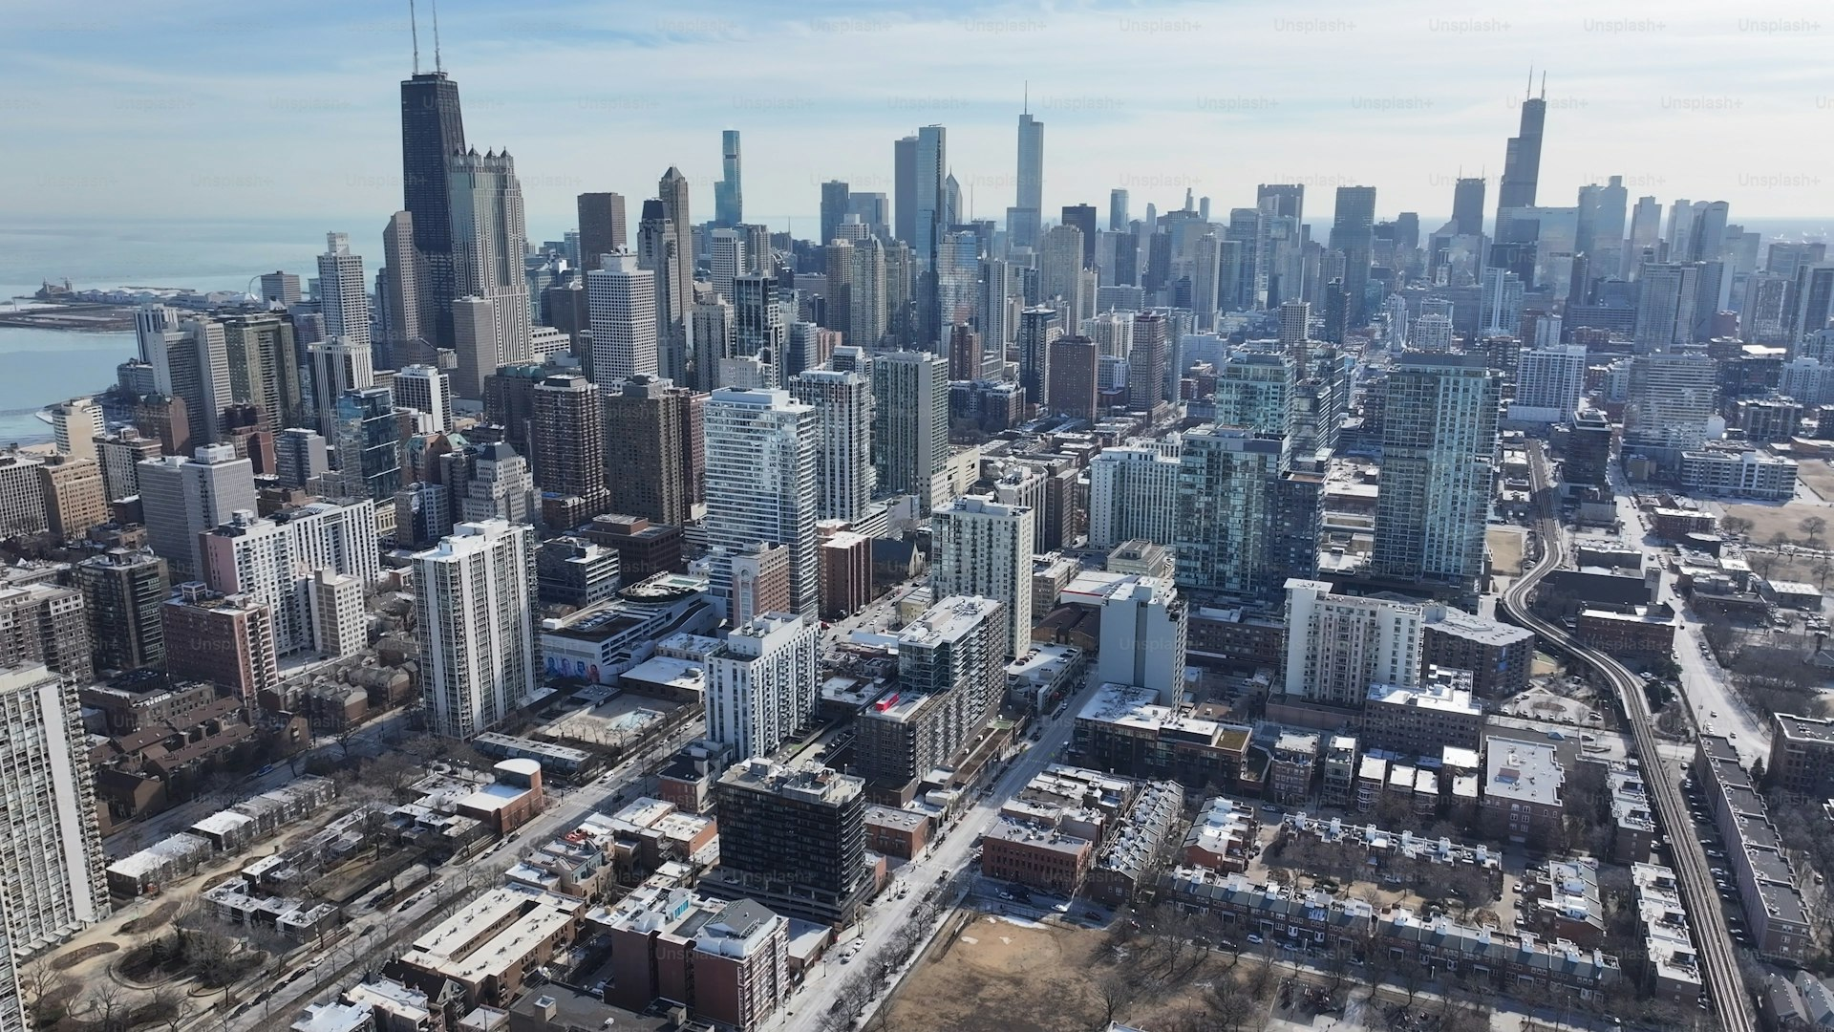
Annual CLE Event
Planning and Logistics — 2026
Chicago Bar Association
Continuing Legal Education Committee
Prepared by: Calvin M. Roth, Committee Member
October 16, 2026 · Chicago Bar Association Hall · 321 S Plymouth Ct

Slide 2
Event Overview
Event Name
Chicago Bar Association Annual CLE Symposium
Date
October 16, 2026
Venue
Chicago Bar Association Hall, 321 S Plymouth Ct, Chicago
Format
In-person with live-stream option
Expected Attendance
130 to 150 registered attorneys
MCLE Credit Hours
6.0 general, 1.0 professional responsibility
Committee Contact
Calvin M. Roth — calvin.roth@Finthesiss.ai

Slide 3
Session Schedule — October 16, 2026
Time | Session Title | Speaker | Format | Credits
8:30 AM | Registration and Networking | - | Open | 0
9:00 AM | Opening Remarks | Committee Chair | Plenary | 0
9:15 AM | Evidence Updates in Criminal Courts | Hon. Reyes (ret.) | Lecture | 1.0
10:30 AM | Break | - | - | 0
10:45 AM | Ethics in Indigent Defense | Lorraine Okafor | Panel | 1.0 PR
12:00 PM | Lunch Break | - | - | 0
1:00 PM | Effective Cross-Examination | Marcus Traylor | Workshop | 1.5
2:45 PM | Sentencing Advocacy Strategies | TBD | Lecture | 1.5
4:15 PM | Break | - | - | 0
4:30 PM | Closing Panel and Q+A | Committee | Panel | 1.0
5:30 PM | Reception | - | Social | 0

Slide 4
Registration Progress
Registration Summary
Current Registrations
138
Target Attendance
150
Remaining Capacity
12
Pace vs Prior Year
+14%
Early-Bird Closes
Oct 2, 2026
Walk-ins Allowed
Yes (limited)

Slide 5
Event Budget Overview
Category | Budgeted | Projected | Variance | Status
Venue Rental | $4,200 | $4,200 | $0 | Confirmed
Catering and Coffee Service | $2,800 | $2,650 | +$150 | On track
AV and Live-Stream Setup | $1,500 | $1,520 | -$20 | On track
Speaker Honoraria (2 speakers) | $1,800 | $1,800 | $0 | Confirmed
Printed Materials | $600 | $540 | +$60 | On track
Event Admin and Misc. | $400 | $385 | +$15 | On track
TOTAL | $11,300 | $11,095 | +$205 | Under Budget

Slide 6
Action Items and Responsibilities
Action Item | Owner | Due Date | Status
Finalize venue contract and insurance certificate | Committee Chair | Oct 1, 2026 | In progress
Confirm live-stream vendor and test connection | AV Lead | Oct 5, 2026 | Pending
Send speaker confirmation and prep materials | Calvin M. Roth | Oct 3, 2026 | Complete
Publish final session schedule to CBA website | Calvin M. Roth | Oct 7, 2026 | In progress
Coordinate catering headcount with venue | Admin Lead | Oct 10, 2026 | Pending
Prepare name badges and printed programs | Admin Lead | Oct 12, 2026 | Pending
Send final reminder email to all registrants | Calvin M. Roth | Oct 14, 2026 | Pending

Slide 7

Chicago Bar Association
Annual CLE Symposium — October 16, 2026
321 S Plymouth Ct, Chicago, Illinois · 6.0 MCLE Credits · 9:00 AM – 5:30 PM
Chicago Bar Association
Questions — contact the committee at:
calvin.roth@Finthesiss.ai
Prepared by Calvin M. Roth · Cook County Public Defender · CLE Committee

